Slide 1
Section_3
Best Practices

Slide 2
1
INCLUSI. Dalla scuola alla vita, andata e ritorno
(INCLUDED. From School to Life, Back and Forth)

Slide 3
2
A funded training experience on Design Thinking

Slide 4
3
DOORS — Porte aperte al desiderio come opportunità di rigenerazione sociale
(DOORS — Open Doors to Desire as an Opportunity for Social Regeneration)

Slide 5
1
INCLUSI. Dalla scuola alla vita, andata e ritorno

Slide 6
The experience described here is an Italian project that fits within the sphere of special pedagogy, aiming to put in place actions that can facilitate processes of true inclusion within Italian schools.

Slide 7
In Italian public system schools the 300.000 students, the 3,5 % of the student population, is a students with disabilities.

Slide 8
So teacher training appears profoundly relevant given also the ever-increasing number of support teachers, net of the still very poor results obtained by communication and autonomy assistants, accessibility tools for those with motor difficulties and aids for sensory disabilities.

Slide 9
The project involved 52 partners from 5 different regions for 3 years in promoting an equitable school and environments accessible to all, through technologies, professional skills of teachers and educators, public and media representation of frailty, and educational and vocational guidance.

Slide 10
The project was developed by H for Human, the foundation of H-FARM, in particular by the SPARX team. It’s a reality that deals with designing active learning experiences mediated by the technological medium and that involves a group of teachers and trainers with the aim of developing specific skills in the use of technologies and transversal skills to design inclusive learning experiences.

Slide 11
The training course (12 hours live online class in total) came to life in six weekly appointments, during the three-year period 2020 - 2023.

Slide 12
The specific objectives of the experience were:
to train in the practices of creative learning for the design and implementation of experiences that can involve all students in the learning process
to help teachers and instructors in developing an expertise in using these technologies in education, with the aim to redefine teaching action toward more inclusive learning experiences that respect students' different learning times and modes.

Slide 13
The course aimed to introduce the design modes typical of Creative Learning and also to provide participants and learners with concrete tools to introduce within their professional practices.

Slide 14
So the course took on a dual nature:
one more exquisitely aimed at illustrating and presenting the theoretical framework
a second more exquisitely active and practical.

Slide 15
Date | Section | Duration
Feb 15th 2023 | Creative Learning approach the role of technology Intro Scratch TASK: Scratch surprise | 2h
Feb 22th 2023 | Scratch - coding coding in education: a short introduction projects gallery TASK: animate your name! | 2h
March 1st 2023 | Scratch - storytelling 10 blocks intro digital storytelling TASK: conversation though conversation blocks | 2h

Slide 16
Date | Section | Duration
March 8th 2023 | Scratch - video game (chapter 1) Coordinate Gamification in education How to move the sprite with the keyboard TASK: Maze | 2h
March 15th 2023 | Scratch - video game (modulo 2) Maze (portale + level 2) Catch game TASK: Variables / scores + life | 2h
March 22th 2023 | Scratch - video sensing Intro con pagina Exploratorium Examples: let it snow! and Party Hats Step by step: Pop a balloon TASK: Personal project | 2h

Slide 17
The participants ranged in age from 30 to 50 years old and almost all came from the world of education and/or instruction.

Slide 18
The course aimed to proposing engaging and quality experiences, engaging students through a personalized communication system (personalization principle), putting participants in a position to intervene and be involved through constant feedback from the instructor, chat conversations, group work (peer collaboration).

Slide 19
The process was built on a deeply practical approach, proposing real-world contexts for learning that could keep participants connected and involved through hands-on exercises that they had to upload and present in the classroom.

Slide 20
Let’s go now into the merits of the structuring of the project,
in view of the theoretical elements regarding adult learning pathways.

Slide 21
One of the key elements in fostering the engagement and creation of effective and efficient experiences for adults is set a collective goal and a shared vision to motivate students' participation and contribution level.

Slide 22
So the first appointment of the project, entitled Creative Learning, was devoted to sharing how to use the content and the online environment, to breaking the ice between the participants with the aim of creating a welcoming and comfortable atmosphere and above all, showing the structure of the course, both in terms of content, logistic, organization of the practical activities and deliverables to be done at home.

Slide 23
A further key element appears to be related to the role that the teacher - or instructor - has to play, in requiring students to be in charge of a discussion of their teamwork, thus in putting students and female students in a position to manage their learning process, becoming its real protagonists.

Slide 24
In this sense the lessons were designed with the aim of offering the opportunity to share students’ work in plenary, thanks to a relaxed atmosphere, with the goal of receiving feedback and opinions from other classmates, in order to treasure the multiplicity of points of view.

Slide 25
Central to the educational process is the role of the instructor: he or she must play the role of facilitator.
What exactly is meant by a facilitator?

Slide 26
Here some general guidelines for a facilitator, proposed by Rogers (1969, 164-166).
The facilitator:
sets up the atmosphere and climate for learning based on trust and truth

Slide 27
clarifies the learning purposes and helps choose those most appropriate and effective for the group
leverages individual motivations and interests
organizes and makes available a wide range of resources learning
sees himself as a flexible and usable resource for the group by making himself available as an advisor, professor, and counselor
respects both the intellectual content and emotional attitudes of learners

Slide 28
becomes a member of the group, participating personally in activities and paying attention to manifestations that denote deep feelings;
shares his feelings and thoughts with students in a personal way;
is continuously attentive in the classroom to manifestations that denote strong and deep feelings, communicating his empathetic understanding;
strives to accept and acknowledge his or her own limitations.

Slide 29
The facilitator's fundamental task is to listen to the student,
to understand what another individual is saying and to get involved in what he or she is saying.
The experience of the adult student, according to Rogers, is as valuable as that of the teacher, and often in the best groups of adult students it is sometimes difficult to determine who is learning the most.

Slide 30
Facilitator's posture is essential to ensure an effective, efficient and engaging experience for all participants.

Slide 31
During INCLUDED pathway, teachers took such a posture with the aim of becoming appropriately part of the group, trying not to assume a vertical and asymmetrical posture, intercepting the daily interests and experiences of the participants, with the goal of proposing targeted and ad hoc experiences.

Slide 32
Let us consider the next element:
he need to propose non-lecture teaching formats from a scaffolding perspective.
Before going into this point, it is necessary to propose a brief introduction of what we mean by the term scaffolding.

Slide 33
In the original article of Wood et al. (1978), they referred to the scaffolding process as:
the usual type of tutoring situation in which one member ‘knows the answer’ and the other does not (Wood et al., 1978, p. 89).

Slide 34
They viewed scaffolding as being mainly concerned with the adult controlling those elements of the task that are initially beyond the learner’s capacity, thus permitting him to concentrate upon and complete only those elements that are within his range of competence.

Slide 35
Wood et al. (1978) stipulated that in order for learning to occur there had to be a comprehension of the solution even though the learner did not necessarily realise how to achieve it without assistance.

Slide 36
The authors contended that comprehension must precede production in order for the learner to obtain feedback about strategies deployed, in order to determine their effectiveness, while admitting that in some instances serendipitous events or unexpected discoveries could also lead to successful task completion.

Slide 37
Since scaffolding is a concept that needs to be modified to suit the circumstances of implementation (i.e. the scope of the task and the learner’s own zone of development), the nature of the scaffolding process is dynamic.

Slide 38
Several key characteristics of scaffolding can be identified.

Slide 39
the interaction must be collaborative, with the learner’s own intentions being the aim of the process
the scaffolding must operate within the learner’s zone of proximal development. The “scaffolder” must access the learner’s level of comprehension and then draw the learning into new areas of exploration

Slide 40
the scaffold is gradually withdrawn as the learner becomes more competent. In the educational context the final goal is for the learner to become independent, having internalized the knowledge required in order to complete the task.

Slide 41
the scaffold is gradually withdrawn as the learner becomes more competent. In the educational context the final goal is for the learner to become independent, having internalized the knowledge required in order to complete the task.

Slide 42
Now so let’s take into consideration the posture taken by adults within a learning pathway.
The adult who decides to undertake a pathway is also certainly enticed by the operability of the spendability of the proposals at the professional level.

Slide 43
An adult audience also likes an educational pathway that leverages a motivation based on enjoyment.

Slide 44
Let’s see the practical exercises and activities were organized during INCLUSI. Thus, the two-hour course was developed as follows:
1st part: 15' minutes of free conversation about what we saw together in the previous appointment
2nd part: 30' to see together, on a shared screen by both the participants and the lecturers what was produced by the participants regarding the exercises to be done for home
3rd part: 20' short theoretical introduction regarding the topic of the day.

Slide 45
4th part: 10' minute break
5th part: 10', Practice Activation: then, the instructor would show the performance of the exercise on the Scratch platform and ask participants to experiment with their own creation, along the lines of what was shown, within the shared Scratch classroom (which could see everyone, instructors and participants, in sync).

Slide 46
6th part: 20', independent performance of tasks.
7th part: 40', plenary sharing of each task and space to clear doubts and curiosities together, both peer-to-peer and peer-to-teacher.
8th part: 5' minutes of final sharing regarding the conduct of the experience: feedback and opinions.

Slide 47
Let’s take a look into the 5th part of Practice Activation:
participants are advised to use Scratch for Educators, the version for teachers. Each participant has been placed within a virtual classroom, a functional tool since it is configured as a container that can collect all the work done by participants in sync, so all the participants observed and learned from each other's work, but ensuring anonymity since it was not necessary to register with one's name.

Slide 48
Scratch for Educators is a simple and intuitive platform and perfect for the unfolding and delivery of an online course for some reasons:
Student learning choices that exploit personal interests and strengths - themes and content that can reflect the personal inclinations and interests of the students involved is a strength for online student engagement.

Slide 49
Make available a range of both summary and in-depth content for participants - one of the most effective tools for engaging adult learners is, at the end of the training day, a recap of the topics covered and a set of content to be explored in more depth both related to what was seen together, new insights but also guidelines to enable participants to be able to practice independently.

Slide 50
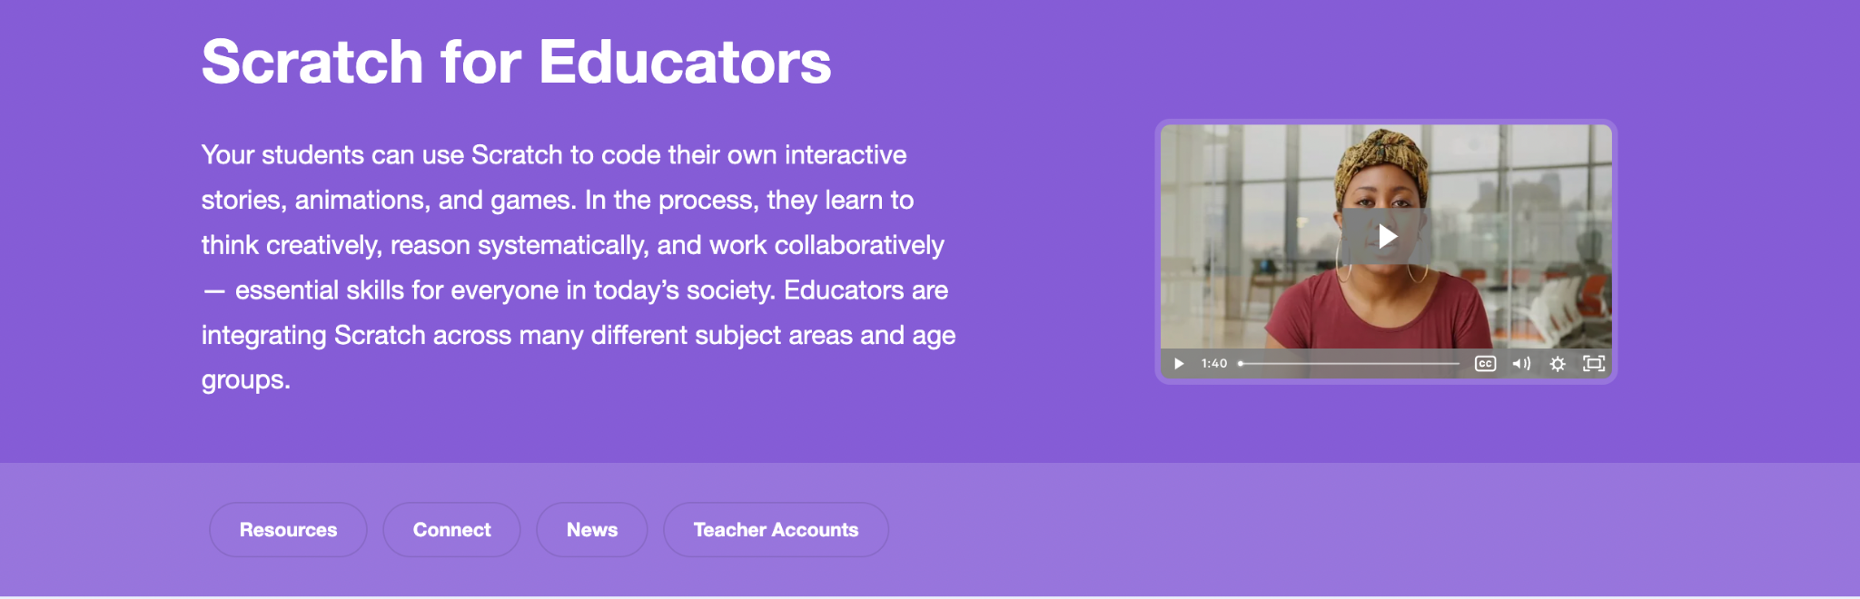


Slide 51
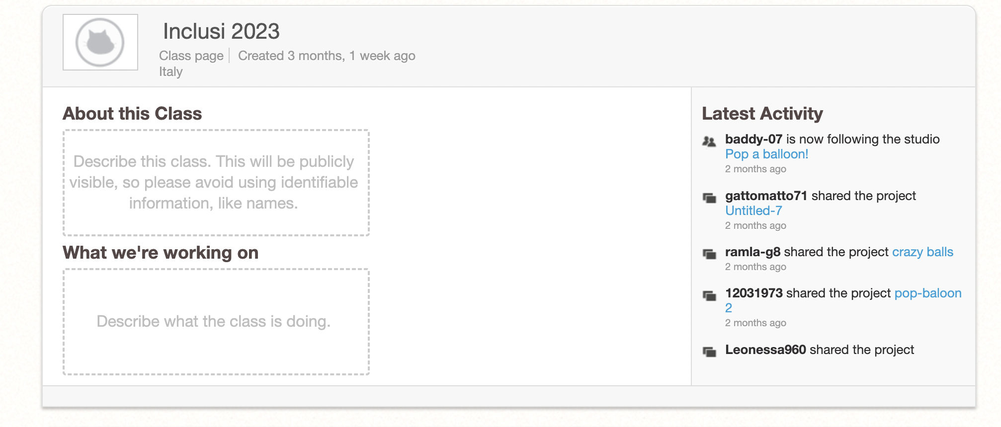

Slide 52
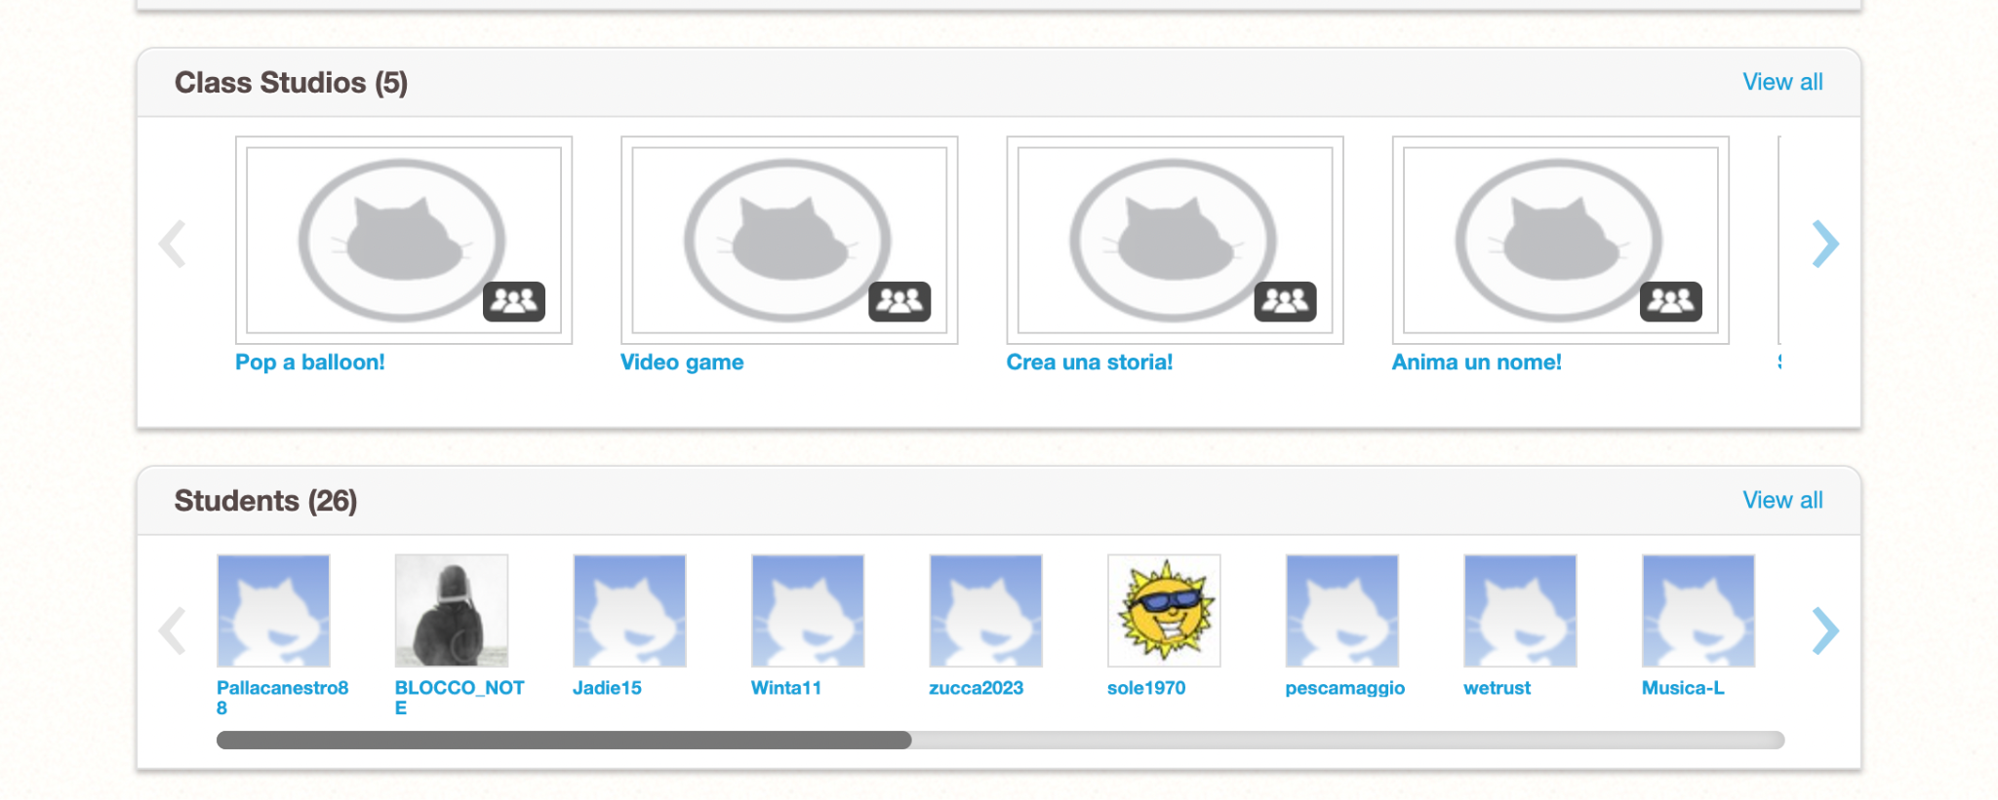

Slide 53
What elements can contribute to adult online learning?

Slide 54
the climate created in the classroom
the diagnostic investigation of students' real needs
the operationalization of training proposals
the expendability for educational paths taken
a final certification that could attest to the course taken and the hours students were involved
a welcome email, where presented the ways in which the experience would be managed and the content that would be covered from time to time.

Slide 55
Which difficulties adults involved in an online learning pathway may face?

Slide 56
Very often individuals do not have enough time to devote to training because they are overburdened with professional or family commitments
strategy: lecturers provided a large database of information for all those who could not attend live, enabling them to train in these terms.

Slide 57
Some adults find it difficult to understand the teacher because of the use of a methodology that is not well accepted or for examples that are not in tune with the adult's lived experiences, or insufficient familiarity with some teaching techniques and cognitive strategies.
strategy: create a relaxed and informal environment, within which the guiding factor was the need to make all participants feel at ease and then felt in a position to shared their work.

Slide 58
2
A funded training experience on Design Thinking

Slide 59
The second experience presented was a course in a corporate environment, untethered from corporate dynamics, for which professionals can freely apply.

Slide 60
It was a Region-funded training course that came to life in 2019, dedicated to employees of an international chemical company. The participants, 10 in all, belong to different business units (marketing, sales, IT, operations, R&D) and hold positions of responsibility, with long-standing industry experience.

Slide 61
The course aimed to introduce to the practices and workings of an approach such as Design Thinking, especially from the perspective of managing and implementing projects. Participants had no expertise in this area but had a desire to acquire skills related to the ability to manage a project and think outside the box.

Slide 62
The course has a total duration of 9h and was divided into 5 meetings. The meetings were developed in presence.

Slide 63
The first meeting was of central importance, as the trainer proposed an introductory workshop to experience a design process from start to finish, highlighting all the most interesting elements of design thinking.

Slide 64
Since Design Thinking can be represented as a process composed of 4 phases (divergent+convergent+divergent+convergent),
the trainer structured the other 4 meetings focusing each time on a specific phase and some of the most used tools.

Slide 65
The first appointment was crucial for a whole series of reasons:
the ice breaking phase (central in light of creating a relaxed atmosphere)
the group-building phase
the phase of creating an appropriate relationship both among peers and between teacher and class.

Slide 66
The practice of the first appointment allows the trainer to understand and frame what may be the tools that can be proposed and experienced by the participants, in light of the potential connections and possible expendability within their field of work.

Slide 67
So the methodology that was applied saw 2 elements placed at the center: experiential learning and teamwork.

Slide 68
Each meeting saw participants alternating between individual and paired or small group activities, during which they materialized their thoughts with markers, post-it notes and templates on which they then discussed and compared together as a group.

Slide 69
The challenging elements for the participants within this course were related to:
the possibility of introducing participants to a field that was new and unfamiliar to them
the terms of possible application

Slide 70
The challenging element for the from the designer's point of view was:
trying to structure proposals for participants who are unlikely to handle design processes such as that of Design Thinking.

Slide 71
In this sense, it will now be possible to go into the phases that accompanied the development of the experience from the trainer's point of view.

Slide 72
Thanks to the contact with the client, in this case a freelancer and the client an educational institution, began the 1th phase.
It was possible to collect the first information that then guided the design phase:
Course duration (required)
Learning objectives
Maximum number
Minimum number
Spaces and tools available.

Slide 73
Thanks to the contact with the client, in this case a freelancer and the client an educational institution, began the 1th phase of the design process.
It was possible to collect the first information that then guided the design phase:
Course duration (required)
Learning objectives
Maximum number
Minimum number
Spaces and tools available.

Slide 74
With this information gathered, it is possible to begin
the 2th phase and design and plan the content of the course, dwelling on the correct division of content through the meetings, correctly identifying the objectives at the end of each meeting, and creating a calendar of activities.

Slide 75
The 3th phase is a research phase, that is, a reconnaissance of ideas made by the trainer in order to prepare a wide range of content to work on during the course conduct.

Slide 76
The 4th phase constitutes the outline planning of all the meetings. The trainer defines in advance all the content and all the activities, leaving room for modification to the net of what then emerges from the meeting with the participants and attendees (their preferences, their tastes, their inclinations).

Slide 77
The 5th phase sees the trainer working on the content to be presented visually: canvases, presentations and other visuals useful in the classroom.

Slide 78
The 5th phase sees the trainer working on the content to be presented visually: canvases, presentations and other visuals useful in the classroom.

Slide 79
So the role of the trainer is to collect as much as possible the stimuli from the environment, all the data collected in the field, in an iterative process.
Then, the trainer revises and improves the design of the next meeting, including through the use of the same materials produced by the participants.

Slide 80
But what is Design Thinking?

Slide 81
Design Thinking is an iterative process in which we seek to understand the user, challenge assumptions, and redefine problems in an attempt to identify alternative strategies and solutions that might not be instantly apparent with our initial level of understanding.

Slide 82
Design Thinking revolves around a deep interest in developing an understanding of the people for whom we’re designing the products or services.

Slide 83
Design Thinking provides a solution-based approach to solving problems.
It is a way of thinking and working as well as a collection of hands-on methods.

Slide 84
Design Thinking helps in the process of questioning:
questioning the problem, questioning the assumptions and questioning the implications.

Slide 85
Design Thinking involves ongoing experimentation: sketching, prototyping, testing, and trying out concepts and ideas.

Slide 86
We’ll take into consideration the 5-phase model proposed by the Hasso-Plattner Institute of Design at Stanford, the d.school.
We’ve chosen d.school’s approach because they’re at the forefront of applying and teaching Design Thinking.

Slide 87
All variants of Design Thinking are very similar and embody the same principles, which were first described by Nobel Prize laureate Herbert Simon in The Sciences of the Artificial in 1969.

Slide 88
5-phases:
Empathise – with your users
Define – your users’ needs, their problem, and your insights
Ideate – by challenging assumptions and creating ideas for innovative solutions
Prototype – to start creating solutions
Test – solutions It is important to note that the five phases, stages, or modes are not always sequential.

Slide 89
They do not have to follow any specific order and can often occur in parallel and repeat iteratively. Given that, you should consider these phases as the modes or phases that contribute to an innovative project, rather than sequential steps.

Slide 90
What is the utility of Design Thinking to promote systemic Instructional Design Practices in the workplace?

Slide 91
Synergies exist between instructional design (ID) and design thinking, although it is not yet clear how, and to what effect, design thinking can be used in the development of instructional materials.

Slide 92
Traditionally Instructional Design models were slow and inflexible due to linear design stages which must be completed step by step and focus too much on content and not enough on student-educator interaction.
Then, the focus of design has moved from content creation to learning experience, an emphasis on speed, flexibility and non-linear processes.

Slide 93
Instructional Design become an approach to designing and developing learning experiences.

Slide 94
So there were the connection with Design thinking, that is an agile user-centered approach and has begun to be applied in the field of Instructional Design.

Slide 95
Design Thinking is a process that embodies empathetic design of solutions and iterations of ideation and innovation while engaging in problem solving.

Slide 96
Design thinking has been found to improve outcomes in many contexts as it can lead to innovative human-centred solutions which are more inclusive

Slide 97
So in the context of Instructional Design, the introduction of design thinking is part of the increasing shift towards more agile and user-centered approaches.

Slide 98
However, the key difference between Design Thinking and other Instructional Design models is the emphasis on human-centered design and in particular empathizing with students or end users and seeing them as a person rather than an input.
(Stefaniak, 2020)

Slide 99
3
DOORS — Porte aperte al desiderio come opportunità di rigenerazione sociale

Slide 100
This experience is an online pathway organized in 5 weeks, held between January and March 2021.
There were 50 students involved, all adults, divided into groups of 25. The participants were primary and secondary teachers, museum educators, and students.

Slide 101
The course focuses on issues related to Creative Learning and constructionism, thus starting from a solid theoretical framework but including a whole series of practical activities necessary for the purpose of understanding some key concepts.

Slide 102
It was interesting because before the online edition that we will recount here it had always been held in presence.
So the trainers had to completely redesign the experience, to adapt it specifically to the online environment, with the aim of maintaining the quality experience, trying to involve the participants as much as possible.

Slide 103
Now we’ll present the development of this experience from the choices made by the trainers.

Slide 104
The tools
The first essential decision that had to be made was related to the type of platform that could ensure:
the best enjoyment by the participants
break rooms could be created to be able to work in groups
a quality collaborative experience.

Slide 105
An additional need for the trainers was related to the possibility of being able to share multiple screens at the same time, so it was also necessary to evaluate the performance of a platform that could effectively support the group in this direction.
The choices fell on 2 platforms:
Jitsi and Unhangout.

Slide 106
Another element was also related to communication.
It is necessary to use effective tools to be able to stay in touch with the participants with a view to engagement and guidance and to be able to use appropriate tools that can allow easy and direct contact between participants, for the development of a real community.

Slide 107
For communication with participants
Trainers started a newsletter (managed with Mailtrain) and started a website. In order to connect participants with each other, they invited everyone to take part in a Telegram channel.

Slide 108
Telegram turned out to be an appropriate platform since:
does not involve joining a social network
can be used from both smartphones and computers very easily
has a single channel of conversation allows each contribution to be valued (without scattering between numerous thematic threads, as can happen in a forum).

Slide 109
In each online meeting every participant had to carry out a small project.
Just in the spirit of scaffolding, at the beginning of each meeting the trainers would present an initial demo version of the project to be implemented, provide a series of examples through a gallery of examples, and then, proceed in their own implementation in the subgroups for the duration of 1 hour and a half under the guidance and observation of the classroom facilitators (5 for both groups).

Slide 110
After the individual production phase, there is the plenary sharing phase.
Once the meeting was over, the participants received an email with some proposals to deepen the course themes:
a video or reading
a project proposal to be carried out during the week
some guiding questions to reflect on the experience in a personal learner's journal.

Slide 111
Let’s see the organization of each week in detail, in order to understand what kind of dynamics and strategies were put in place by the trainers.

Slide 112
Before Phase - Week 0
Trainers sent an email to everyone with a short clip introducing the course highlighting objectives, content, and how to participate, and introducing themselves.

Slide 113
Before Phase - Week 0
Attached to the same email was a video-tutorial and a PDF step-by-step guide for creating a teacher account, with an invitation to make and upload to a gallery a project in which to make the kitten do something surprising (Scratch Surprise).

Slide 114
Before Phase - Week 0
The proposed content guided the participants to create an account needed to carry out the projects and more importantly, to create a first project that could allow them to become familiar with what they will later need to do together during the course.

Slide 115
Week 1
The first meeting aimed to break the ice both among the participants and with the actual platform and to allow participants to get acquainted and familiar with the mode of participation.

Slide 116
Week 1
At the end of the meeting, the trainers assigned tasks, namely exploring each other's projects and leaving a comment. With the aim of providing participants with spaces for insight and engagement, the trainers had shared with participants a video clip where we narrated Creative Learning through the spiral of creative learning and the 4Ps.

Slide 117
Week 2
The online environment expanded by aiming to engage participants in an even more hands-on approach, offering them the chance to create a project in the wake of the opportunities to connect physical and digital.

Slide 118
Week 2
Participants were invited to "augment" their reality by trying to animate an object or the environment around them. This is a particularly relevant perspective, as it gives an opportunity to think about ways of activating participants-pretty much bodily and physical-in their online presence.

Slide 119
Week 2
Also the trainers proposed a home task, to be done independently, the reading of the article "What we mean by learning" by Aaron Falbel and Edith Ackermann.

Slide 120
Week 3
The focus remained on actual hands-on construction, allowing participants to experience the scope of Creative Learning through Tinkering.

Slide 121
Week 3
The trainers proposed real construction to the participants through the use of materials found at home, introducing interaction with elements found in their home environment:
the activity of building a spinning top.

Slide 122
Week 3
Trainers used a padlet to show some examples, useful resources and finally share the participants' creations providing a synchronous collective sharing multimedia whiteboard, a real space within which everyone can interact at the same time, even while maintaining anonymity.

Slide 123
Week 3
To keep engagement high, as experiences and activities that can be completed at home, the trainers assigned and shared an activity from the Exploratorium repertoire (Shadow Remix) and a reading to accompany "It looks like fun, but are they learning?" by Mike Petrich, Karen Wilkinson and Bronwyn Bevan, as a theoretical framework.

Slide 124
Week 4
The penultimate week was characterized by a particularly active experience based on sharing: in fact, the activity that the trainers proposed was “pass it on!”.

Slide 125
Week 4
It’s an activity within which participants were invited to create a small project on the Scratch platform for half the duration of the meeting, and then have it continued by another participant while they in turn continued someone else's project, in a deeply collaborative way.

Slide 126
Week 5
The last meeting was organized differently from the others. Trainers proposed 4 thematic breakouts to the participants:
one dedicated to designing a course for their own students to put into practice the creative learning principles they had encountered during the course

Slide 127
Week 5
one to delve into the use of blocks that were less thoroughly covered during the course, such as variables, messages, clones, sensors, through the creation of a Sprite Art project.
one to work on debugging personal projects (or ones you were working on with your class) that have already been done but are not working
one to reflect on the role of the teacher, reading together and commenting on an excerpt in Italian from the book Lifelong Kindergarten by Mitchel Resnick.

Slide 128
Some reflections from the trainers, regarding the resources put in place to support participants
The creation of an ad-hoc website, newsletter and experiential sheets facilitated the involvement of all participants, especially to support the different styles of participation within the groups.

Slide 129
It allowed them to use the (little) time available in the weekly meeting to experiment concretely, postponing the more theoretical in-depth study to the readings or videos and thus leaving the collective and online space for actual construction and work.

